Slide 1
401- Information System
Concept Of Systems
By Hiren Mistry
VTCBB

Slide 2
System in an Organization
A system is an organized collection of parts that are highly integrated in order to accomplish an overall goal.
The system has various inputs which are processed to produce certain outputs that together, accomplish the overall goal desired by the organization. There is ongoing feedback among these various parts to ensure they remain aligned to accomplish the overall goal of the organization.
Inputs to the system include resources such as raw materials, money, technologies and people.
Process aligned, moved along and carefully coordinated, ultimately to achieve the goals set for the system
Outputs are tangible results produced by processes in the system, such as products or services for consumers. Another kind of result is outcomes, or benefits for consumers
Feedback Is a review or response from customer or user.
VTCBB

Slide 3
System in an Organization
Most systems share common characteristics
  Systems have structure, defined by parts and their composition;
  Systems have behavior, which involves inputs, processing and outputs of material, energy, information, or data;
  Systems have interconnectivity: the various parts of a system have functional as well as structural relationships between each other.
  Systems have by themselves functions or groups of functions
VTCBB

Slide 4
Business as a System
Business
  Row materials, paper stationary, statistical reports are the basic leads the business.
  Manufacturing of goods or products with proper algorithm or structure.
  After Manufacturing we get finished goods which is the final product which are ready to go to market to sale.
  Reviewer do reviewing in market about sold product of these company and get the experience of customers or clients which helps to make product error or improvement
System
  Input like date, information are the main or initial component to work in system.
  After Input we do processing on data which contain calculation , filtering etc.
  With the help of processing we get the useful information as output which has some meaning or purpose.
  The most important component of System is Feedback. It lead the System works more easier and effective.
VTCBB

Slide 5
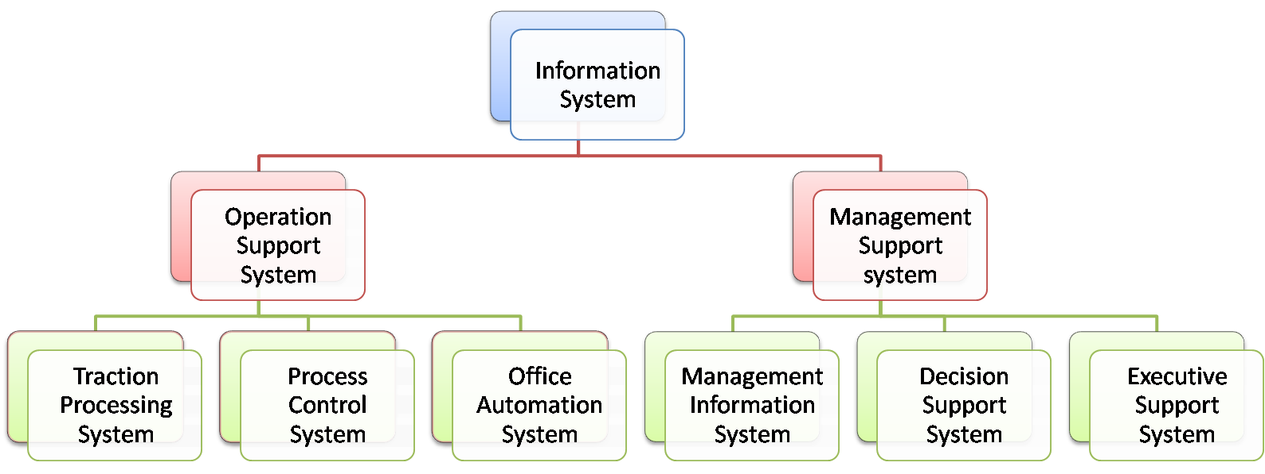
Types of Systems
Supports
Business
Operations
Support of
Managerial
Decision Making
Processing
Business
Transactions
Control of
Industrial
Process
Office
Communication and Productivity
Pre specified
Reporting
For Manages
Interactive
Decision
Support
Information
Tailored for
Executives
VTCBB

Slide 6
Deterministic probabilistic system
Deterministic System
  has a single result or set of set of results given a set of input parameters
  conceptual model of policies applied to a system for understanding everything that has and will occur in the system, based on the physical outcomes
  every action, or cause, produces a reaction, or effect, and every reaction, in turn, becomes the cause of subsequent reactions.
Probabilistic System
  system will have results that vary
  also called stochastic model, process, or system
  solved with the Monte-Carlo method. In this case, a computer program uses a pseudo random number generator to provide values of the attributes in the systems that vary. The program provides an assessment of the uncertainty of results.
VTCBB

Slide 7
Deterministic probabilistic system
Probabilistic System (Cont..)
  The alternative to Monte-Carlo methods is to solve the problems using the mathematics of probability.
  can be very complicated to do in some cases .
VTCBB

Slide 8
Open and close systems
Open System
  are computer systems that provide some combination of interoperability, portability, and open software standards.
  a system which continuously interacts with its environment.
  interaction can take the form of information, energy, or material transfers into or out of the system boundary, depending on the discipline which defines the concept.
  refer to systems that interact with other systems or the outside environment
VTCBB

Slide 9
Open and close systems
Close System
  refer to systems having relatively little interaction with other systems or the outside environment.
  is an example of a close system in that it is a relatively self-contained, self-maintaining unit that has little interacts or exchange with its environment.
  A closed system is something we cannot externally add anything new to.
VTCBB

Slide 10
Overview of business functions in an organization
Human Resources
  Recruitment and retention
  Dismissal (Notice)
  Redundancy
  Motivation
  Professional development and training
  Health and safety and conditions mat work
  Liaison with trade unions
VTCBB

Slide 11
Overview of business functions in an organization
Sales and Marketing
  Market research
  Promotion strategies
  Pricing strategies
  Sales strategies
  The sales team
  Product – advice on new product development, product improvement, extension strategies, target markets
VTCBB

Slide 12
Overview of business functions in an organization
Research and Development
  New product development
  Product improvements
  Competitive advantage
  Value added
  Product testing
  Efficiency gains
  Cost savings
VTCBB

Slide 13
Overview of business functions in an organization
Production/Operations
  Acquiring resources
  Planning output – labour, capital, land
  Monitoring costs
  Projections on future output
  Production methods
  Efficiency
VTCBB

Slide 14
Overview of business functions in an organization
Customer Service
  Monitoring distribution
  After-sales service
  Handling consumer enquiries
  Offering advice to consumers
  Dealing with customer complaints
  Publicity and public relations

Slide 15
Overview of business functions in an organization
Finance and Accounts
  Cash flow
  Monitoring income/revenue
  Monitoring expenditure
  Preparing accounts
  Raising finance
  Shares
  Loans
  Links with all other functional areas
VTCBB

Slide 16
Overview of business functions in an organization
Administration and IT
  Managing estates – cleaning, health and safety, maintenance, security
  Reception
  Clerical work – reporting, recording, record keeping, communication
  Overview of quality control
  Use of IT systems
VTCBB

